Slide 1

CMSC 137
Data Communications and Networking
Lecture Module
22 – Transport Layer

Slide 2
Module 22: Transport Layer
Rozano S. Maniaol
Lecturer

Slide 3
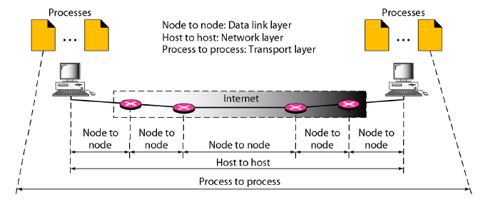
Introduction
The transport layer is responsible for the delivery of a message from one process to another

Slide 4
Client/Server Paradigm
An application program on the local host, called the client, needs services from an application program on the remote host, called a server

Slide 5
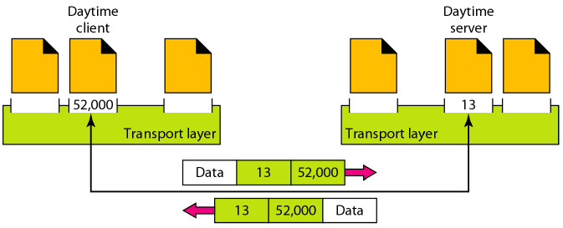
Port Number
16-bit integers between 0 and 65,535
Client program defines itself with a port number (ephemeral port number), chosen randomly by the transport layer software running in the client host
Servers use universal port numbers (well-known port number)

Slide 6
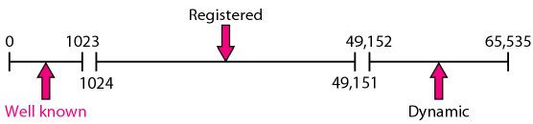
Port Number
Well-known ports – ports ranging from 0 to 1023 and are assigned and controlled by the Internet Corporation for Assigned Names and Numbers (ICANN)
Registered ports – ports ranging from 1024 to 49,151 and are not assigned or controlled by ICANN. They can only be registered to prevent duplication.
Dynamic (or private) ports – ports ranging from 49,152 to 65,535 and are neither controlled nor registered. They can be used by any process

Slide 7
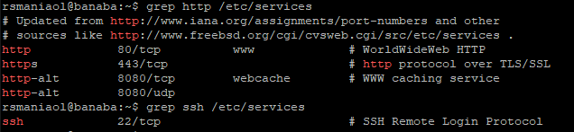
Port Number
In UNIX, the well-known ports are stored in a file called /etc/services. Each line gives the name of the server and the well-know port number. Use grep utility to extract the line to get corresponding desired application

Slide 8
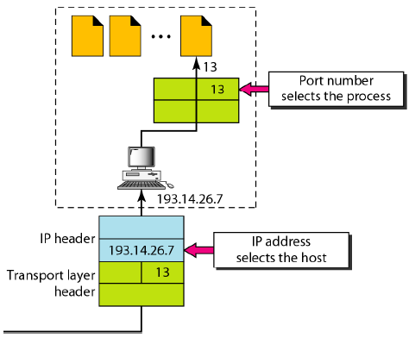
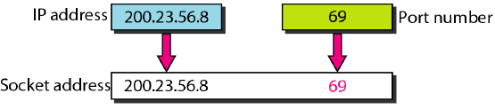
Socket Address
IP Address vs Port Numbers
Socket Address

Slide 9
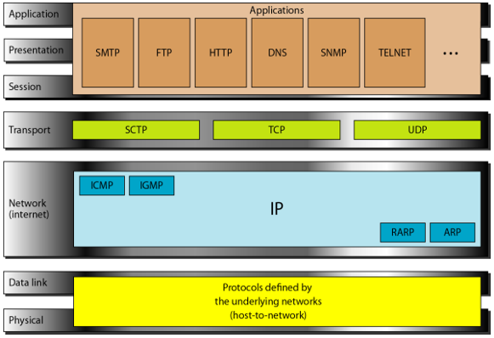
UDP, TCP, SCTP in TCP/IP Protocol Suite

Slide 10
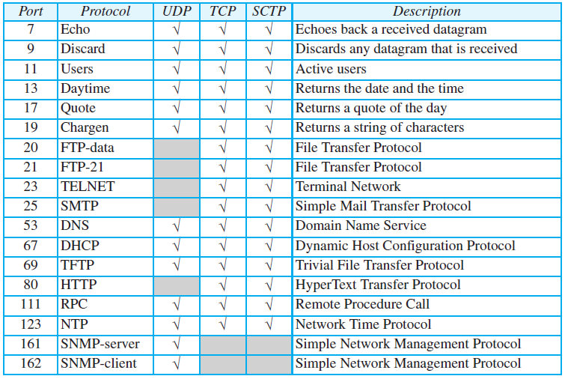
Some well-known ports

Slide 11
User Datagram Protocol

Slide 12
User Datagram Protocol (UDP)
Connectionless, unreliable transport protocol
Does not add anything to IP except provide process-to-process communication
Simple protocol using minimum overhead
RFC 768

Slide 13
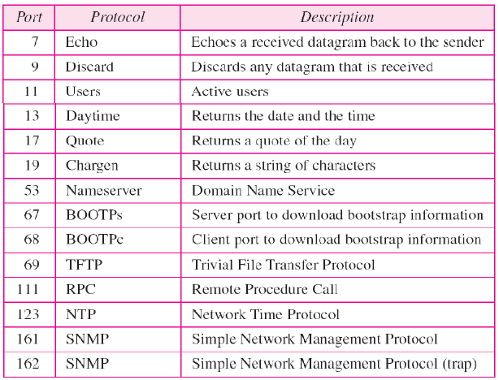
UDP

Slide 14
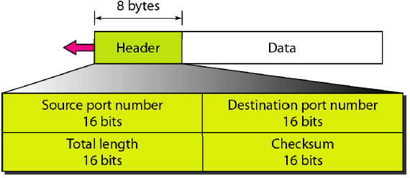
UDP Header
Source port number – 16-bit long number used by the process running on the source host
Destination port number - 16-bit long number used by the process running on the destination host
Length – 16-bit field that defines the total length of the user datagram, header plus data; define up to 65,535 bytes
Checksum – used to detect errors over the entire user datagram

Slide 15
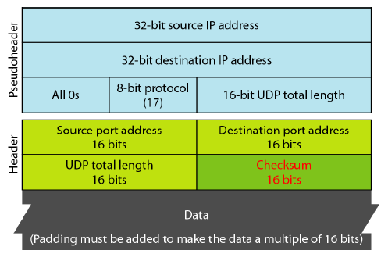
Pseudoheader for checksum calculation

Slide 16
Question
Given the content of a UDP header in hexadecimal format
CB84000D001C001C
What is the source port number?
Source port number is the 1st 4 hexadecimal digits (CB84)₁₆, which means the source port is 52100
What is the destination port number?
Destination port number is the 2nd 4 hexadecimal digits (000D)₁₆, which means the destination port is 13
What is the total length of the user datagram?
3rd hexadecimal (001C)₁₆ define the length of the whole UDP packet as 28 bytes

Slide 17
Question
Given the content of a UDP header in hexadecimal format
CB84000D001C001C
What is the length of the data?
Length of the whole packet minus the length of the header, or 28 – 8 = 20 bytes
Is the packet directed from a client to a server or vice versa?
Since the destination port number is a well-known port, the packet is from the client to a server
What is the client process?
The client process is the Daytime

Slide 18
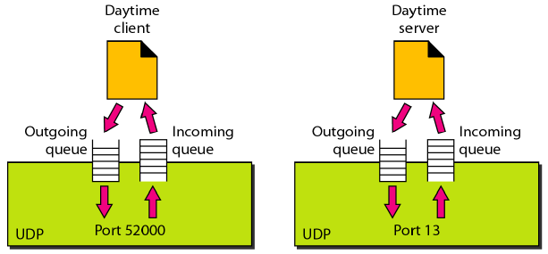
Queuing
Some implementation create both an incoming and outgoing queue associated with each process; some only create an incoming queue
If no queue, UDP discards the user datagram and ask ICMP to send a port unreachable message to the server

Slide 19
Uses of UDP
Suitable for a process that requires simple request-response communication
Suitable for a process with internal flow and control mechanism, e.g. TFTP
Suitable for multicasting
Used for management processes such as SNMP
Used for some routing protocols such as Routing Information Protocol
Used for interactive real-time applications that cannot tolerate uneven delay between sections of a received message

Slide 20
Transmission Control Protocol

Slide 21
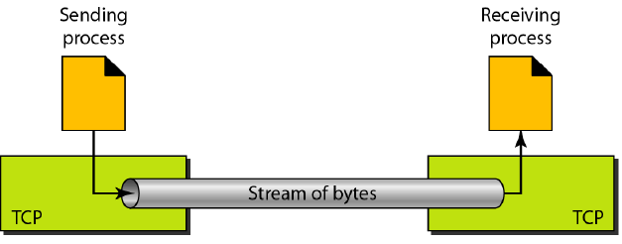
Transmission Control Protocol (TCP)
Connection-oriented, reliable transport protocol
Unlike UDP, it allows the sending process to deliver data as a stream of bytes and allows the receiving process to obtain data as stream of bytes
RFC 793

Slide 22
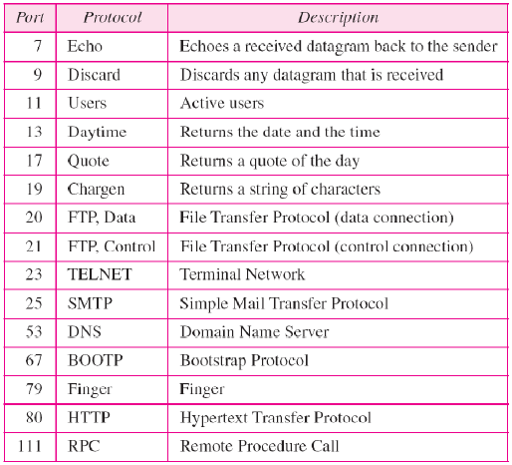
TCP

Slide 23
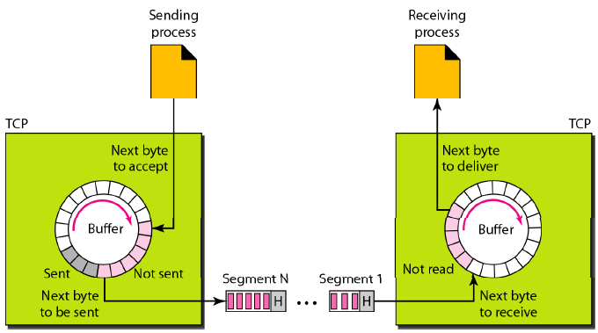
Buffering

Slide 24
TCP Features
Numbering System
  Byte number – TCP numbers all data bytes that are transmitted in a connection. Numbering is independent in each direction and starts with a randomly generated number between 0 and 2³² -1
  TCP assigns a sequence number to each segment that is being sent. The sequence number for each segment is the number of the first byte carried in that segment
  When a connection is established, both parties can send and receive data at the same time. Each party uses an acknowledgment number to confirm the bytes it has received

Slide 25
TCP Features
Flow control – receiver of data controls the amount of data that are to be sent by the sender
Error control – to provide reliable service, TCP implements an error control mechanism
Congestion control – amount of data sent by the sender is not only controlled by the receiver, but is also determined by the level of congestion in the network

Slide 26
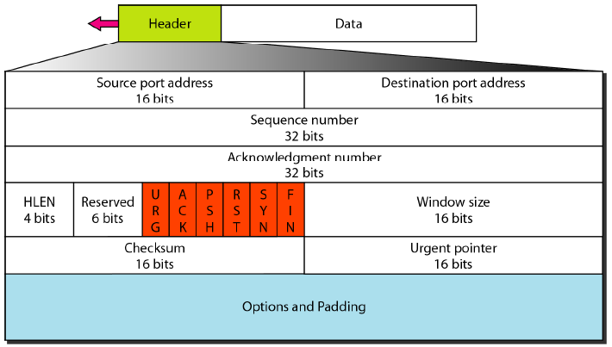
TCP Segment Format

Slide 27
TCP Segment Format
Source port address – 16-bit field that defines the port number of the application program in the host that is sending the segment
Destination port address – 16-bit field that defines the port number of the application program in the host that is receiving the segment
Sequence number – 32-bit field that defines the number assigned to the first byte of data contained in the segment. During connection establishment, each party uses a random number generator to create an initial sequence number (ISN)

Slide 28
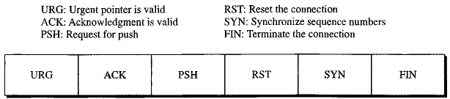
TCP Segment Format
Acknowledgment number – 32-bit field that defines the byte number that the receiver of the segment is expecting to receive from the other party
Header length – 4-bit field indicates the number of the 4-byte word in the TCP header
Reserved – 6-bit field for future use
Control – 6 different control bits or flags

Slide 29
TCP Segment Format
Window size – 16-bit field that defines the size of the window, in bytes, that the other party must maintain. Normally referred to as the receiving window (rwnd) and has max value of 65,535 bytes
Checksum – 16-bit field where the calculation is same as UDP. Inclusion of the checksum in TCP is mandatory while it is optional in UDP
Urgent pointer – 16-bit field that defines the number that must be added to the sequence number to obtain the number of the last urgent byte in the data section of the segment
Options – Can be up to 40-bytes of optional information

Slide 30
TCP Connection
TCP establishes a virtual path between the source and destination
TCP uses the services of IP to deliver individual segments to the receiver, but it controls the connection itself
It requires 3 phases: connection establishment, data transfer, and connection termination

Slide 31
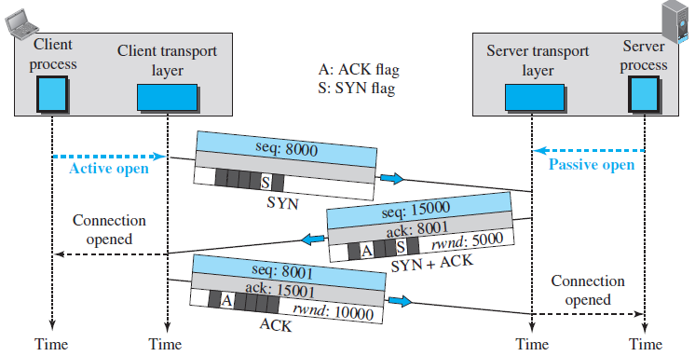
Connection Establishment
Three-way Handshaking
*A SYN+ACK segment cannot carry data, but it does consume one sequence number
*An ACK segment, if carrying no data, consumes no sequence number

Slide 32
Connection Establishment
Process starts with the server where it tells its TCP that it is ready to start a connection (passive open)
A client that wishes to connect to an open server tells it TCP that it needs to be connected to that particular server (active open)
A rare situation (simultaneous open) may occur when both process issue an active open. Both TCP transmit a SYN + ACK segment to each other, and one single connection is established between them

Slide 33
Connection Establishment
Susceptible to the SYN flooding attack
  Malicious attacker sends a large number of SYN segments to a server, pretending that each of them is coming from different clients by faking the source IP address in the datagrams
  The server, assuming that the clients are issuing an active open, allocates the necessary resources and then sends the SYN + ACK segments to the fake clients which are lost

Slide 34
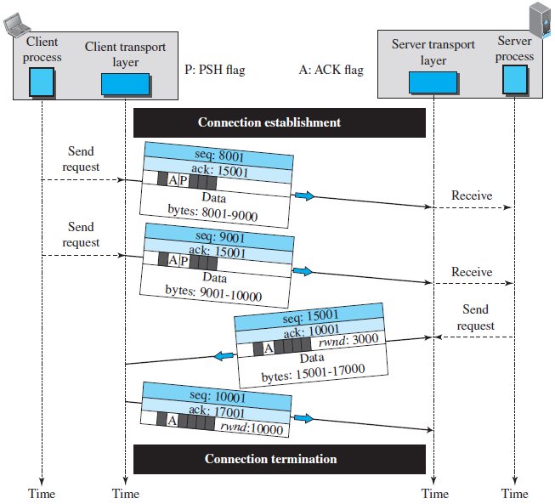
Data Transfer

Slide 35
Data Transfer
After connection is established, bidirectional data transfer can take place. The client and server can both send data and acknowledgments
Pushing Data – The sending TCP must not wait for the window to be filled, it must create a segment and send it immediately
Urgent Data – the sending application program wants a piece of data to be read out of order by the receiving application program

Slide 36
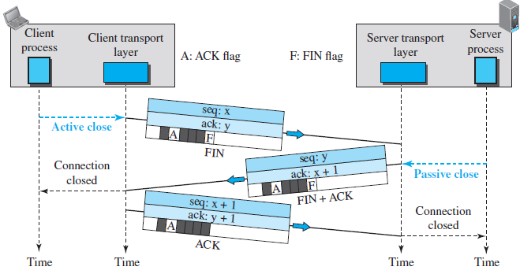
Connection Termination
Three-way Handshaking
* The FIN segment consumes one sequence number if it does not carry data

Slide 37
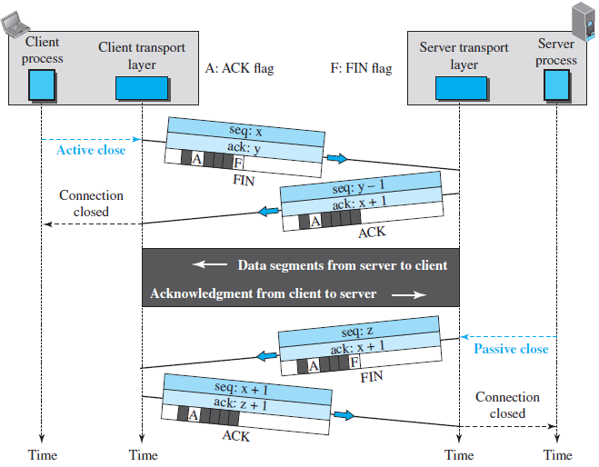
Connection Termination
Four-way Handshaking with half-close option

Slide 38
Stream Control Transmission Protocol

Slide 39
Stream Control Transmission Protocol
New reliable, message-oriented transport layer protocol
Preserves the message boundaries and at the same time detects lost data, duplicate data and out-of-order data
It has also congestion control and flow control mechanisms
RFC 4960

Slide 40
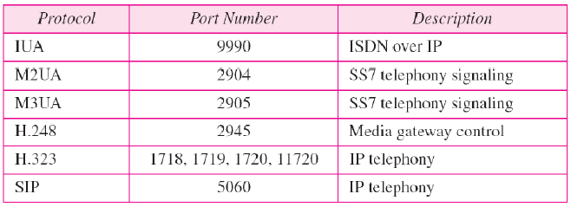
SCTP

Slide 41
SCTP Services
Multiple streams
  In TCP, each connection between client and server involves a single stream, a loss at any point in the stream blocks the delivery of the rest of the data
  Allows multistream service in each connection (association in SCTP terminology)

Slide 42
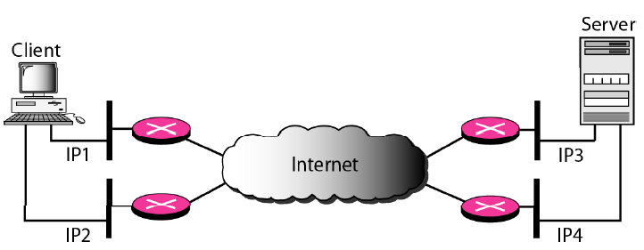
SCTP Services
Multihoming
  A TCP connection involves 1 source and 1 destination IP address, even if the sender or receiver is multihomed (connected to more than 1 physical address with multiple IP address), only one of these IP addresses per end can be used
  Sending and receiving host can define multiple IP addresses in each association
  When one path fails another interface can be used for data delivery without interruption

Slide 43
SCTP Feature
Transmission Sequence Number (TSN): unit of data in SCTP is a data chunk. Data transfer is controlled by numbering the data chunk using TSN
Stream Identifier (SI) – each stream in SCTP needs to be identified
Stream Sequence Number (SSN) – SCTP defines each data chunk in each stream. When a data chunk arrives at the destination, it is delivered to the appropriate stream and in the proper order
Packets – data are carried as data chunks, control information is carried as control chunks. Several control chunks and data chunks can be packed together in a packet

Slide 44
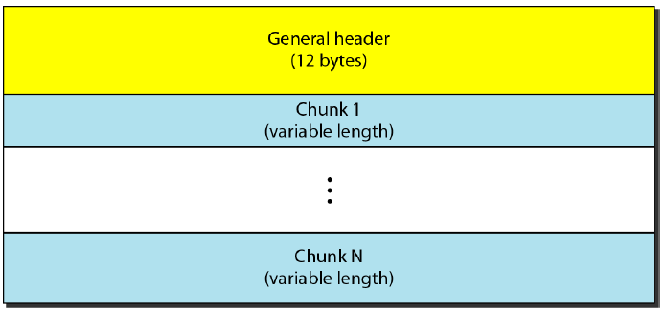
SCTP Packet Format
In an SCTP, control chunks come before data chunks

Slide 45
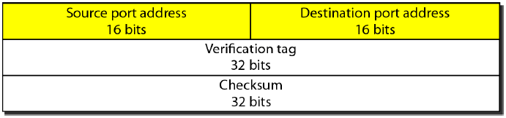
SCTP General Header
Source Port Address and Destination Address – 16-bit field that defines the port numbers of the source and destination respectively
Verification tag – number that matches a packet to an association. It serves as an identifier for the association and is repeated in every packet during the association
Checksum – 32-bit field contains a CRC-32 checksum

Slide 46
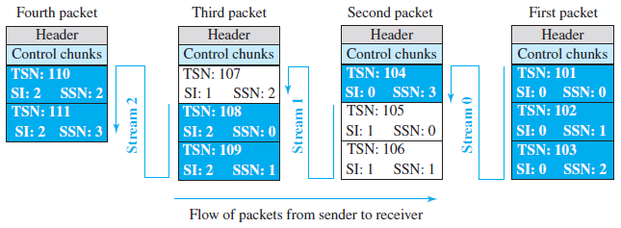
Packets, data chunks, and streams

Slide 47
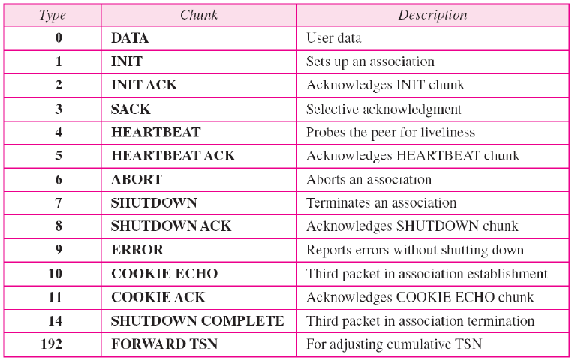
Chunks

Slide 48
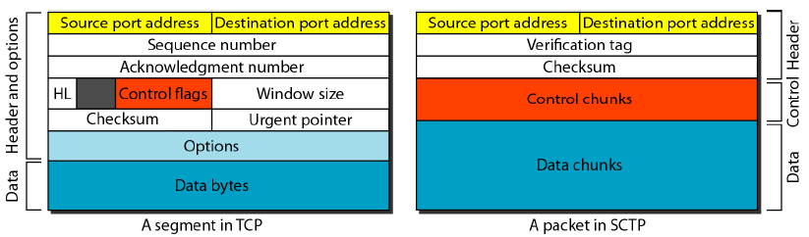
TCP Segment vs SCTP Segment

Slide 49
References
Forouzan, B.A. 2013. Data Communications and Networking, 5th Ed. McGraw-Hill, New York.

